Slide 1
PW - I

Slide 2
Group Members :-
1. Aayush Mishra EN17CS301004
2. Adarsh Pathak EN17CS301017
3. Anshul Verma EN17CS301052

Slide 3
Guided and Coordinated By :-
Mr. Chandrashekhar Kothari sir
Mrs. Ruchi Patel mam

Slide 4
Project Title :-
Deaf Language Identification(Hand Gestures Recognition)

Slide 5
Introduction :-
Motivation :-
• A person with speaking disorders face major problems of expressing their emotions as freely in this world.
• “Not able to utilize” some of the new technologies.

Slide 6
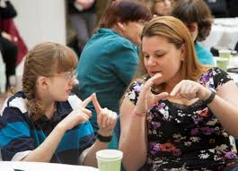

Slide 7
Problem Statement :-
Given a hand gesture, implementing such an application which detects predefined American sign language (ASL) in a real time through hand gestures and providing facility for the user to be able to store the result of the character detected in a txt file, also allowing such users to build their customized gesture so that the problems faced by persons who aren’t able to talk vocally can be accommodated with technological assistance and the barrier of expressing can be overshadowed.

Slide 8
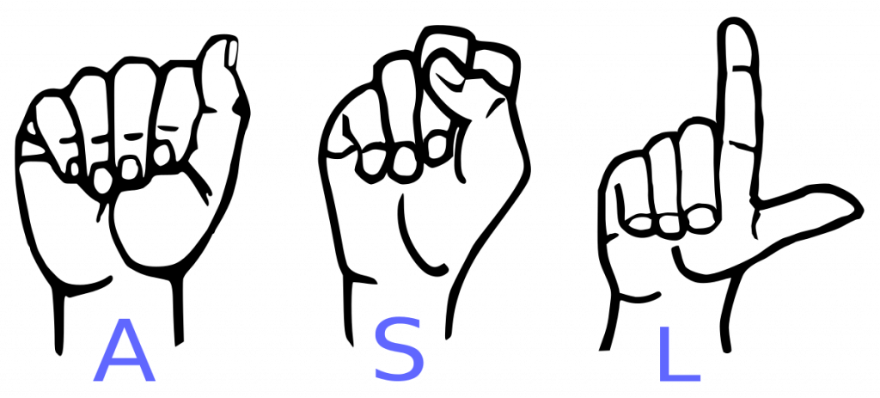

Slide 9
Features of this application :-
Real time (ASL) detection based on gesture made by user.
Customized gesture generation.
Forming a stream of sentences.

Slide 10
Technologies Used :-
Python
TensorFlow framework, Keras API
Real-time computer vision using OpenCV

Slide 11
Core Modules :-
Data Pre-Processing
Scan Single Gesture
Create gesture
Formation of sentence
Exporting
Text to Speech

Slide 12
Conclusion :-
Overshadowing some of the major problems faced by the persons having speech disorders.
They can quickly learn what alphabet is assigned to which gesture with this application.
Add-on to this custom gesture facility is also provided along with sentence formation.

Slide 13
